Slide 1
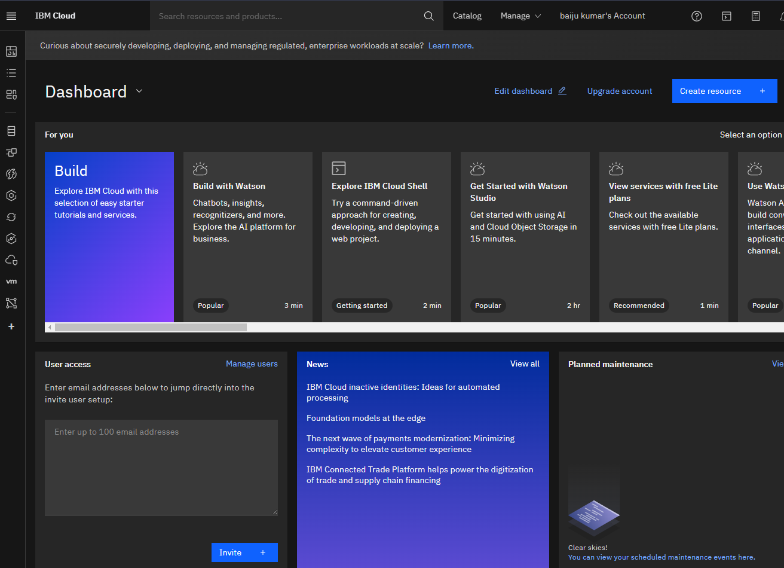

Slide 2
CLOUD data base creation search Db2 in search bare first go to catalog

Slide 4
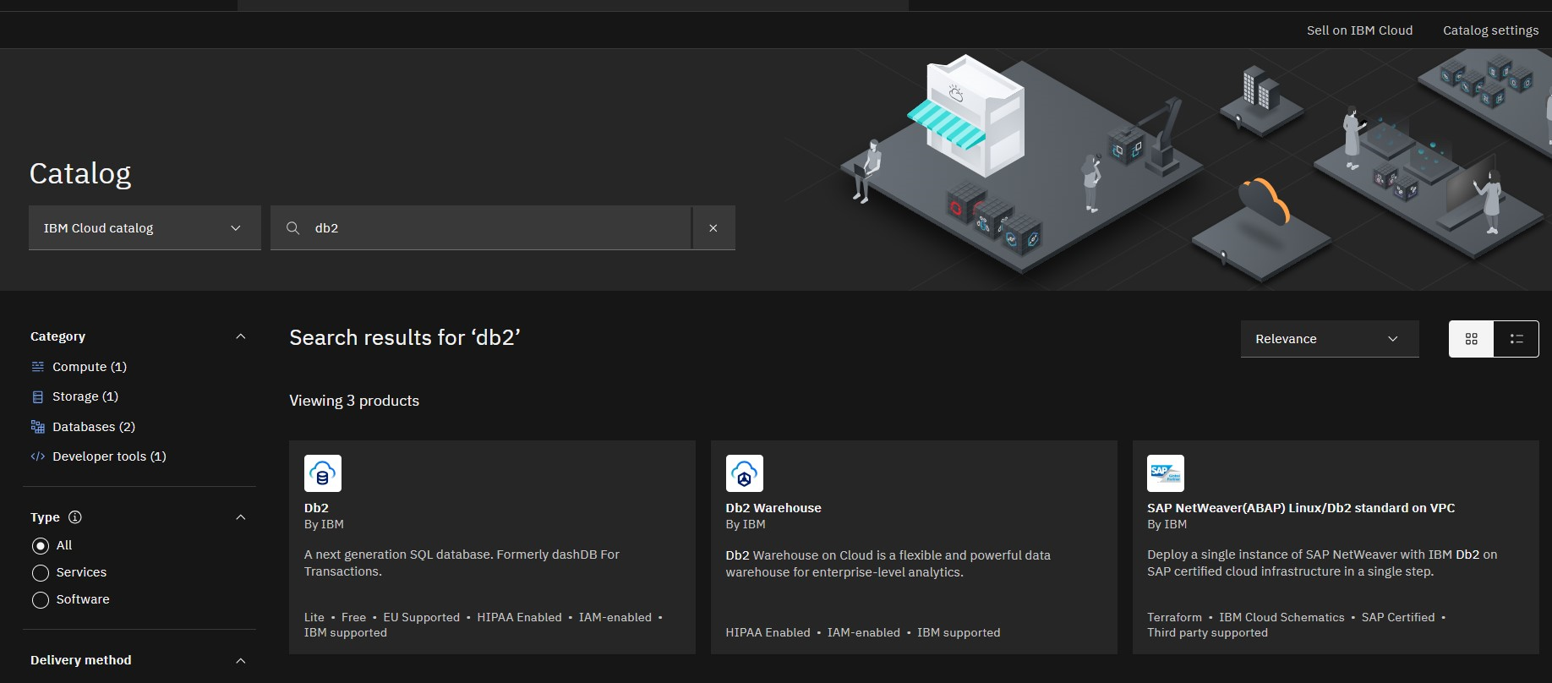

Slide 5
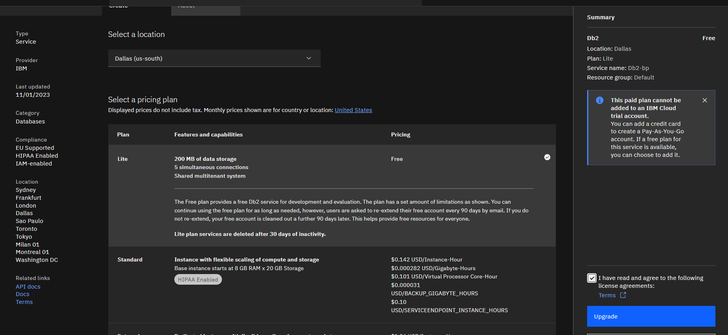

Slide 6
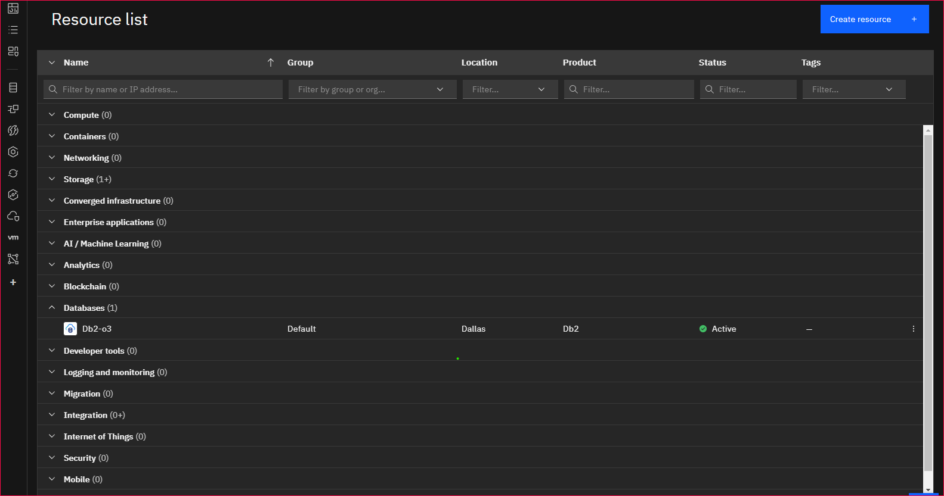

Slide 7
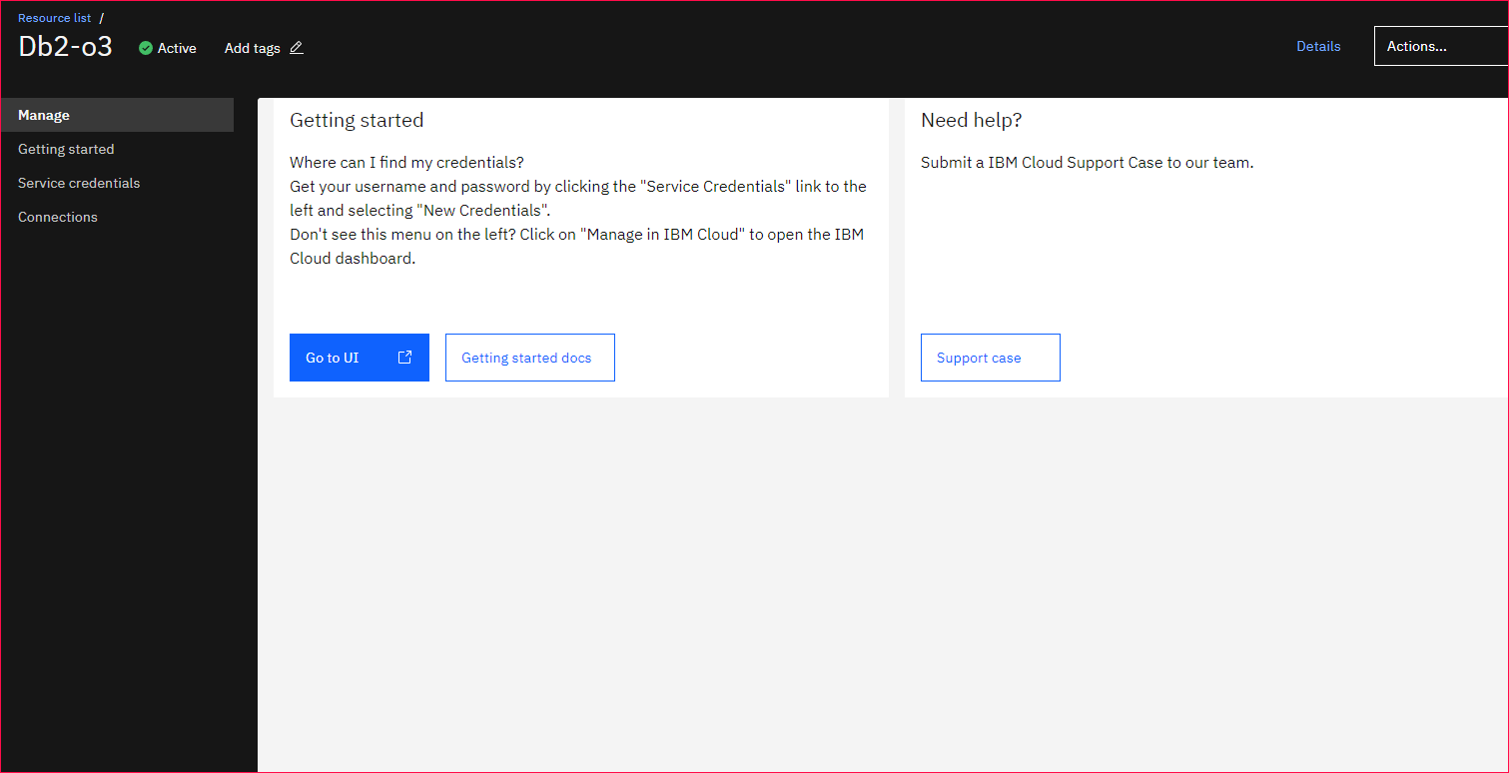

Slide 8
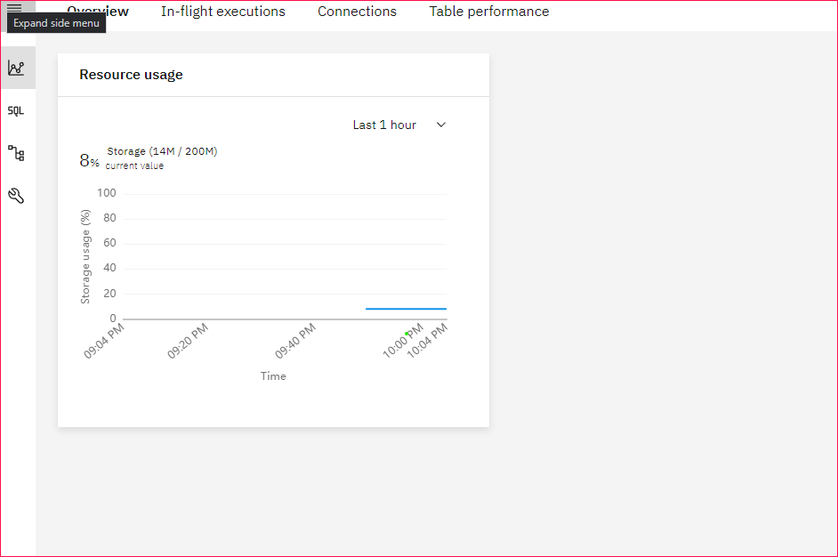

Slide 9
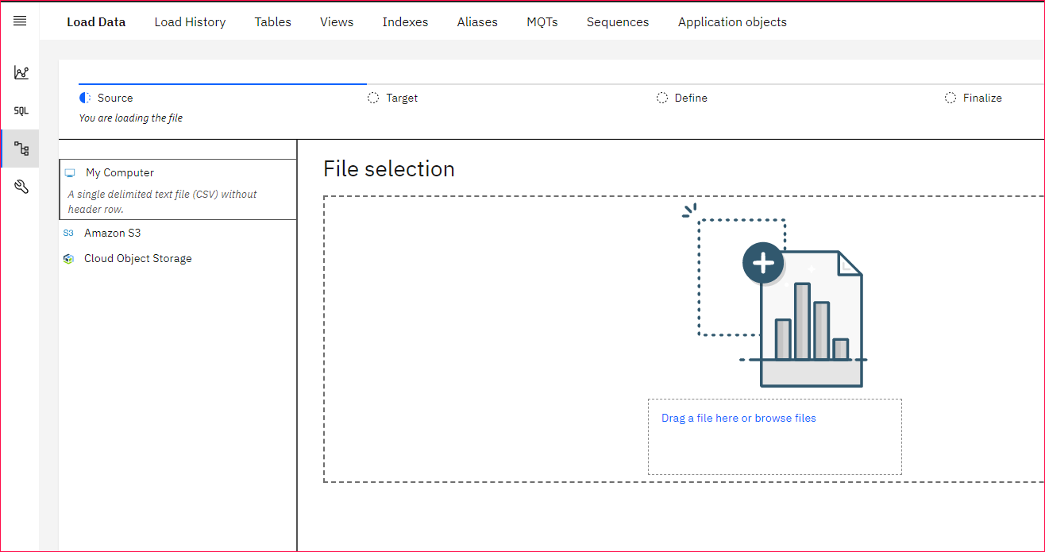

Slide 10
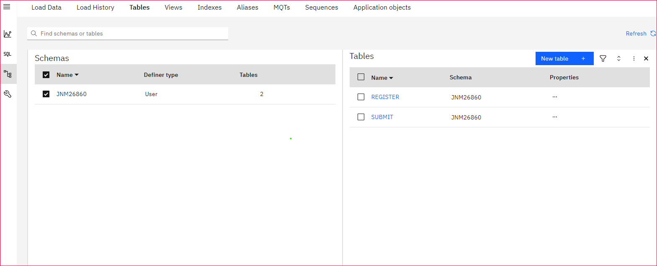

Slide 11
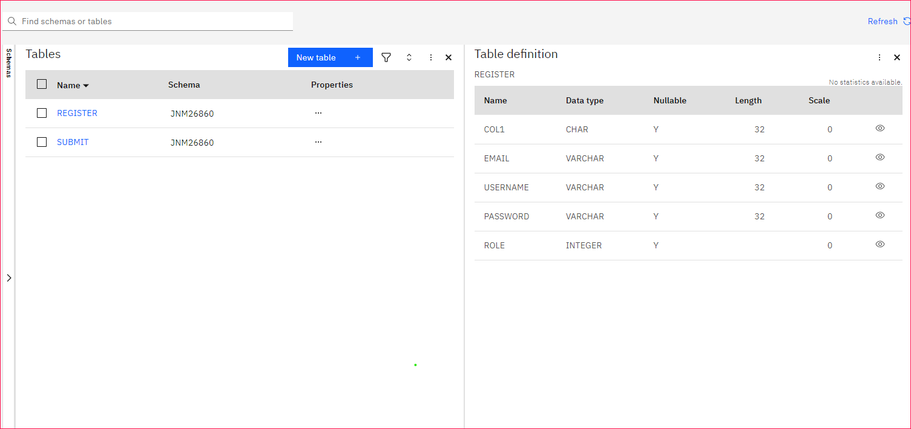

Slide 12
Create table according to your sql command

Slide 13
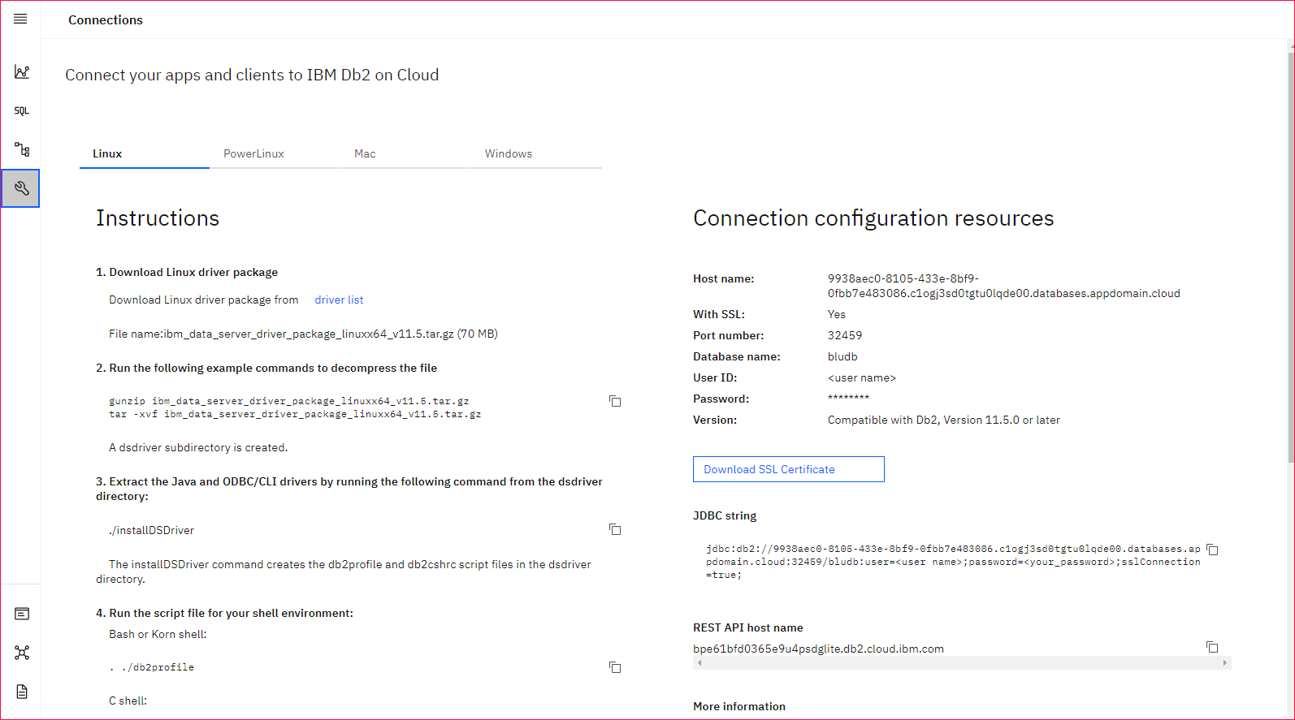

Slide 14
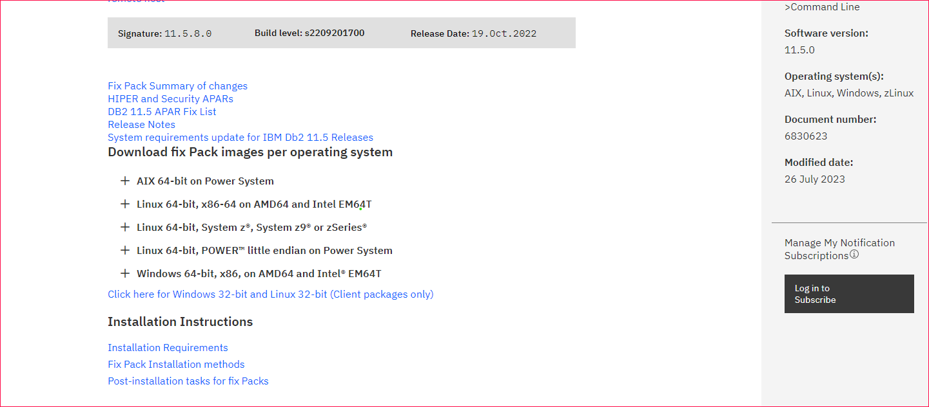
Go according to this and download driver

Slide 15
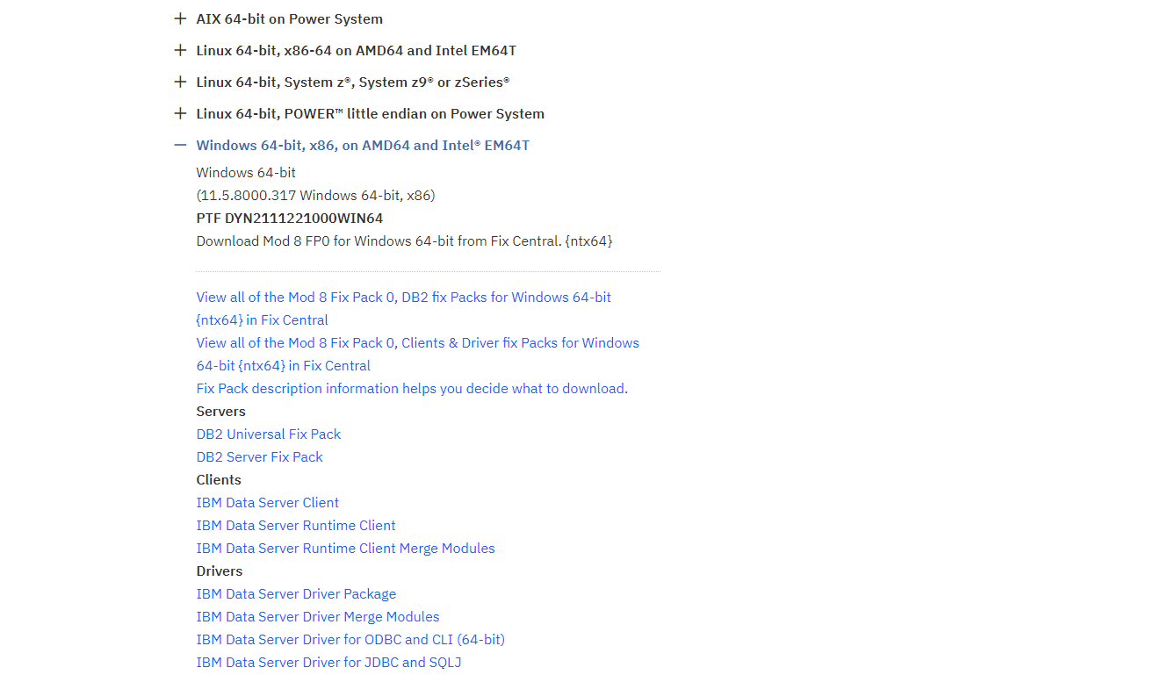

Slide 16
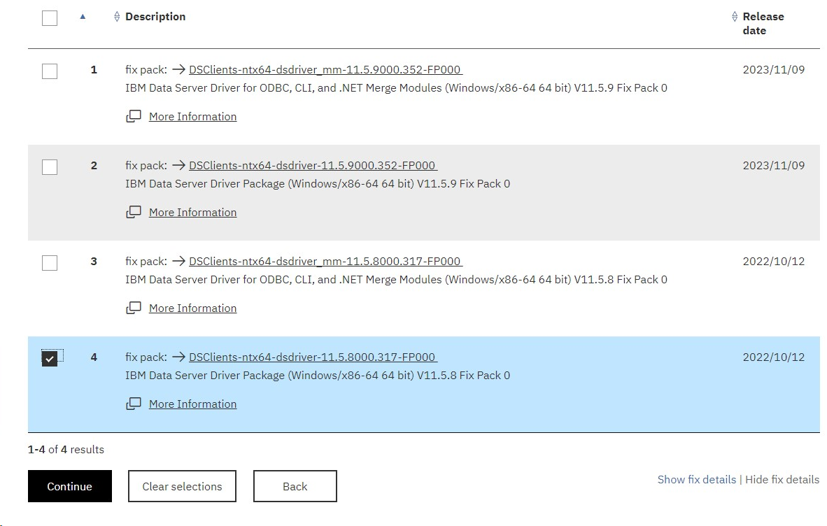

Slide 17
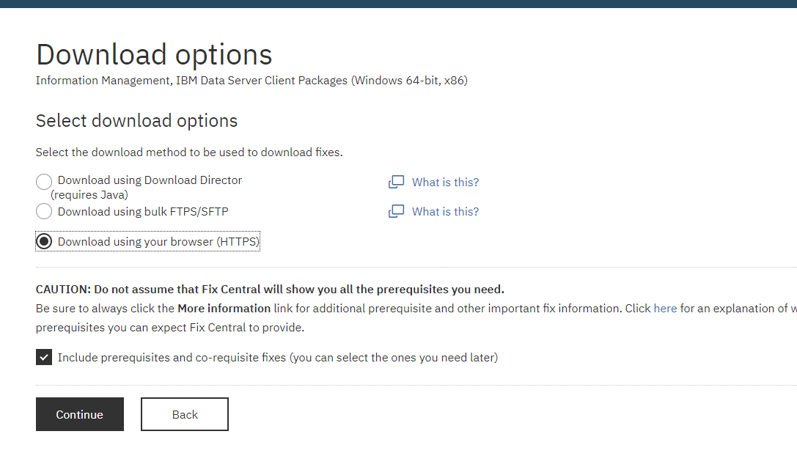

Slide 18
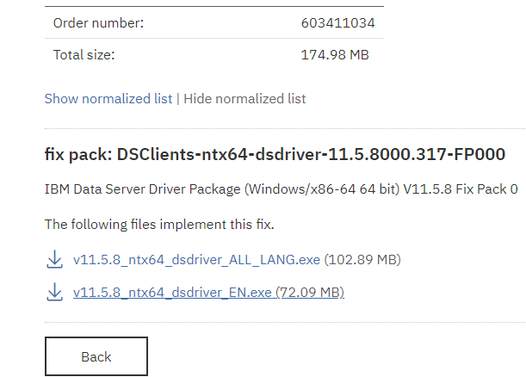

Slide 20
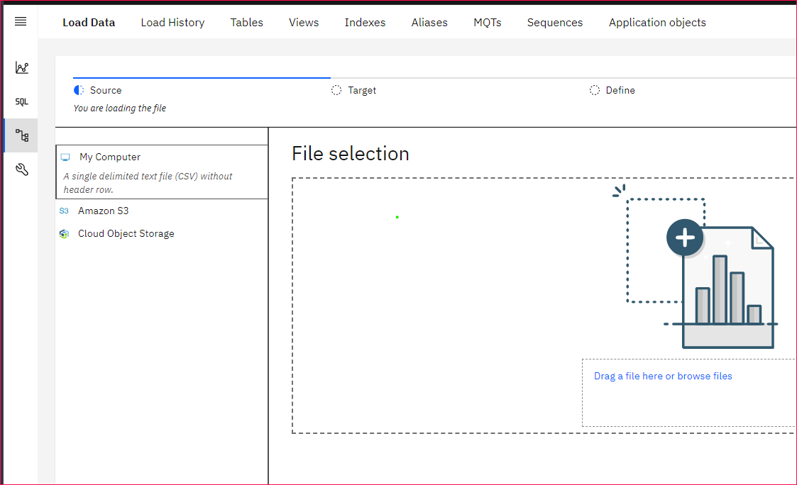

Slide 21
Create service creadentials

Slide 23
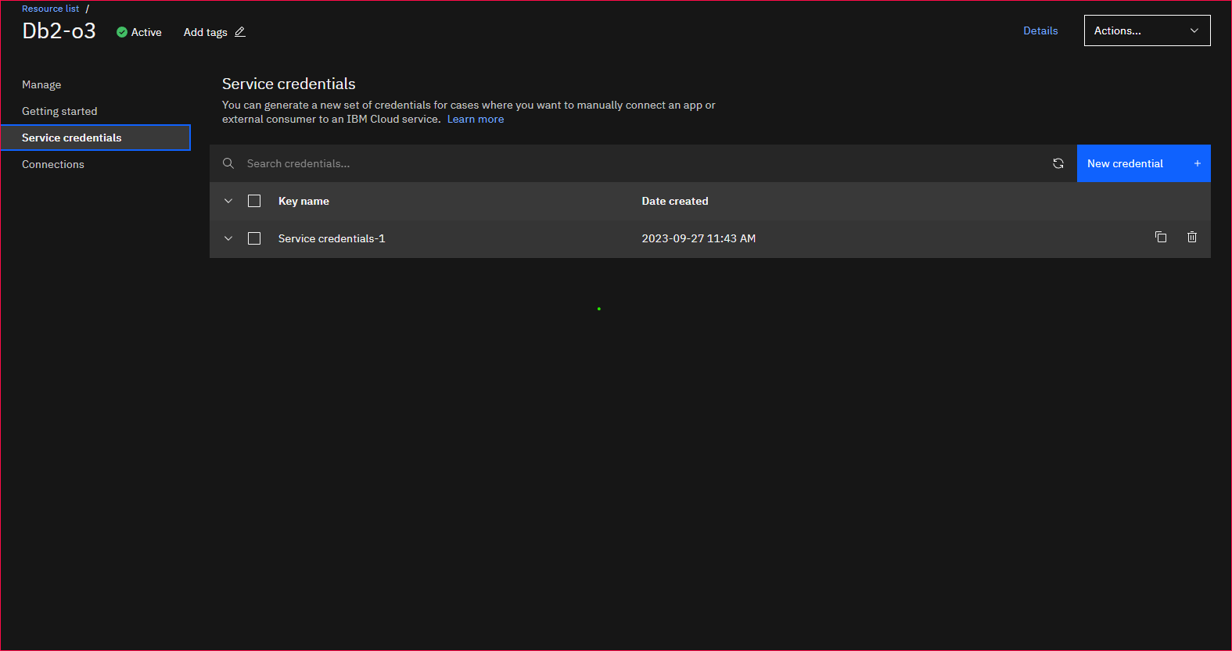

Slide 24
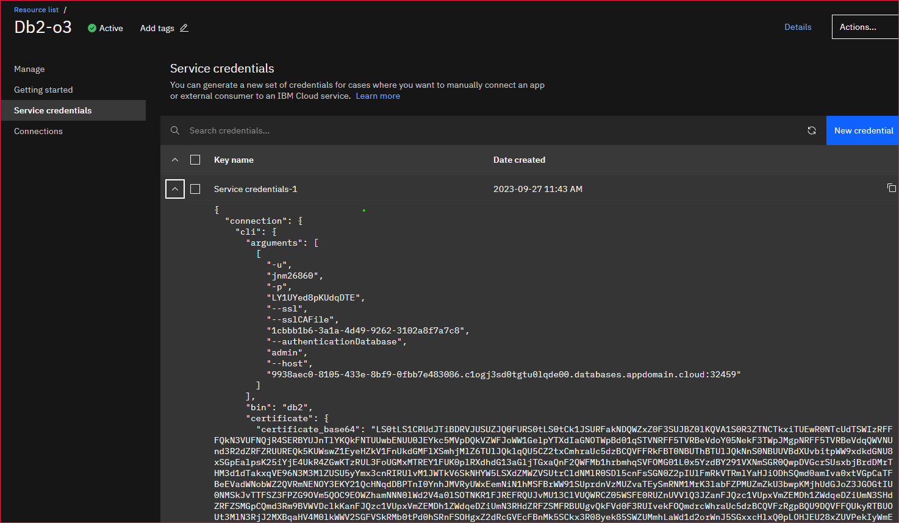
After creating Service credentials open drop down

Slide 25
From above slide You can see in detail and connect your application to data base by giving you database name, hotname, userid, password
import ibm_db
conn=ibm_db.connect("DATABASE=database;HOSTNAME=hostname;PORT=port;PROTOCOL=TCPIP;UID=username;PWD=password",'','')
connState = ibm_db.active(conn)
print(connState)
Import above code in your application.

